Slide 1
He neutrinos emission from sn explosion
Weekly Analysis Meeting – 20/03/25
V. Oliviero, I. Rea, M. Bendahman

Slide 2

What has been done?
Investigated physical scenario;
Studied the emission model;
Produced the sources catalog;
Plan for different analysis strategies.

Slide 3
CUT&COUNT ANALYSIS
Starting with MRF calculation -> template from the collaboration -> Calcrate2.py in Aanet
BUT Calcrate code is not used for time dependent analysis
What did we do?
Using my code to compute the number of signal events from the Murase’s model;
Using Calcrate2.py to compute the number of background events;
Check if the results are in agreement using GraphFlux() function.

Slide 4
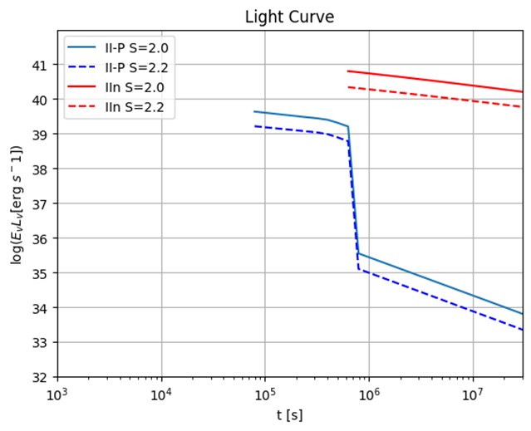
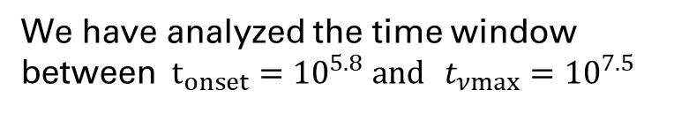

CUT&COUNT ANALYSIS
We studied first SN IIn emission model, with s=2.0.
We have analyzed the time window between$t_{onset}={10}^{5.8} and t_{νmax}{={10}^{7.5}}$
$$t_{νmax}{−t_{onset}=358,7 days∼1 years}$$

Slide 5
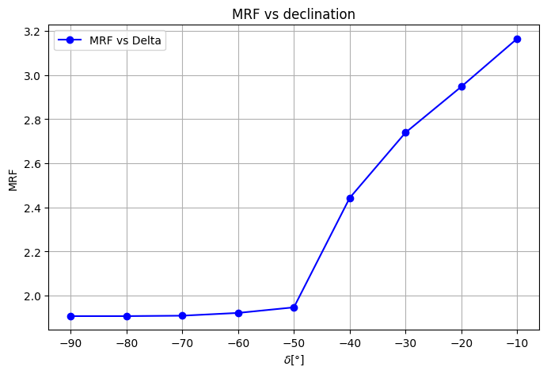
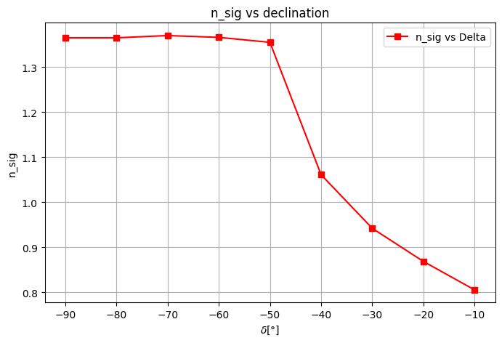

MRF – my code ($ν_{μ}$)
Detector configuration: ARCA21 (202475_5_53_29_DETECTORESPONSE_ARCA21_133_tmva_tracks_v10.ALL_zen_b40_pre_upm01_antinoise_bdt095.root)
Source distance: 1Mpc Supernova Model: SN IIn with CSM interactions
Preliminary results
Preliminary results

Slide 6
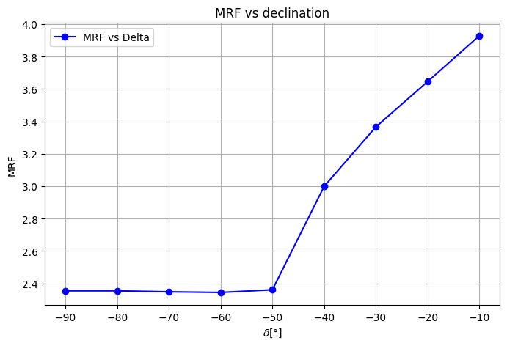
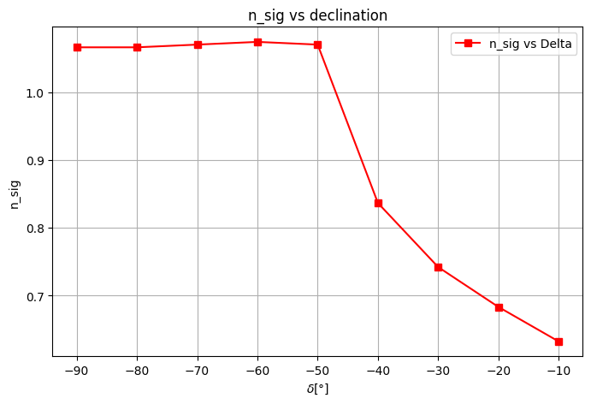

MRF – my code ($\overline{ν_{μ}}$)
Detector configuration: ARCA21 (202475_5_53_29_DETECTORESPONSE_ARCA21_133_tmva_tracks_v10.ALL_zen_b40_pre_upm01_antinoise_bdt095.root)
Source distance: 1Mpc Supernova Model: SN IIn with CSM interactions
Preliminary results
Preliminary results

Slide 7
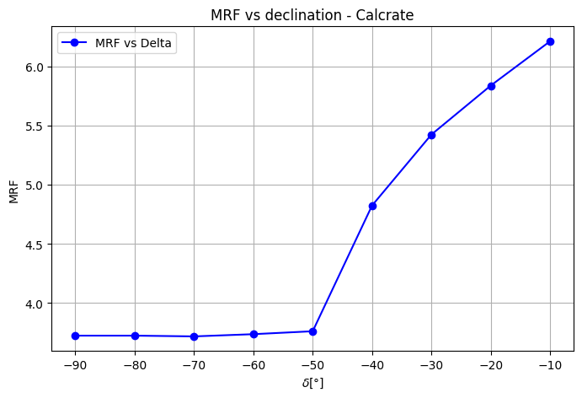
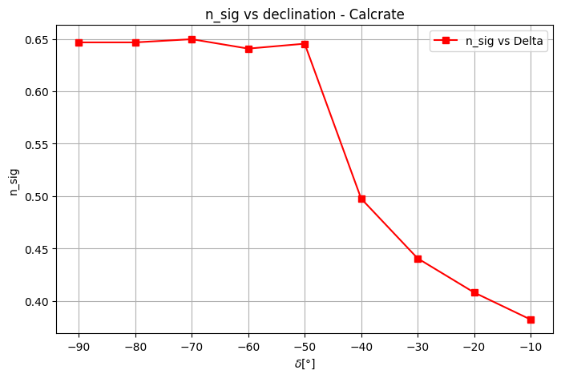

MRF – Calcrate ($ν_{μ}$)
Detector configuration: ARCA21 (202475_5_53_29_DETECTORESPONSE_ARCA21_133_tmva_tracks_v10.ALL_zen_b40_pre_upm01_antinoise_bdt095.root)
Source distance: 1Mpc Supernova Model: SN IIn with CSM interactions
Preliminary results
Preliminary results

Slide 8
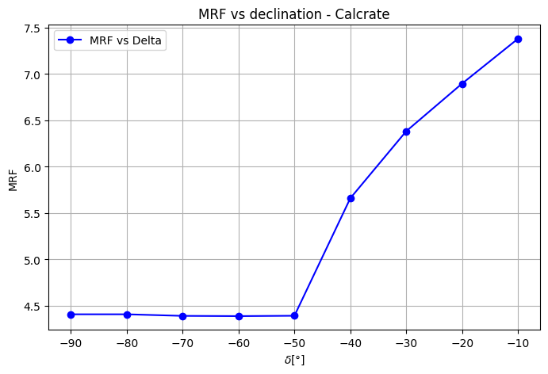
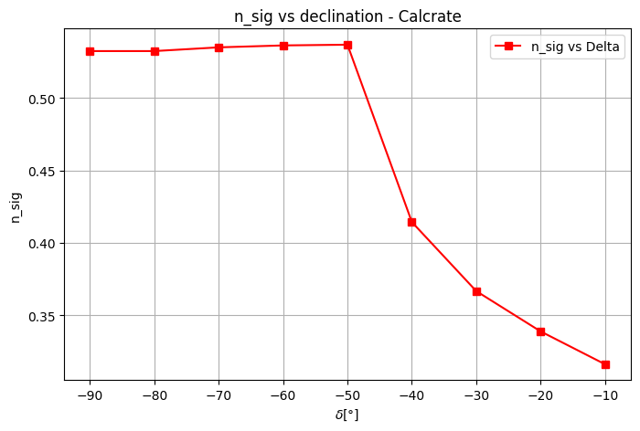

MRF – Calcrate ($\overline{ν_{μ}}$)
Detector configuration: ARCA21 (202475_5_53_29_DETECTORESPONSE_ARCA21_133_tmva_tracks_v10.ALL_zen_b40_pre_upm01_antinoise_bdt095.root)
Source distance: 1Mpc Supernova Model: SN IIn with CSM interactions
Preliminary results
Preliminary results

Slide 9
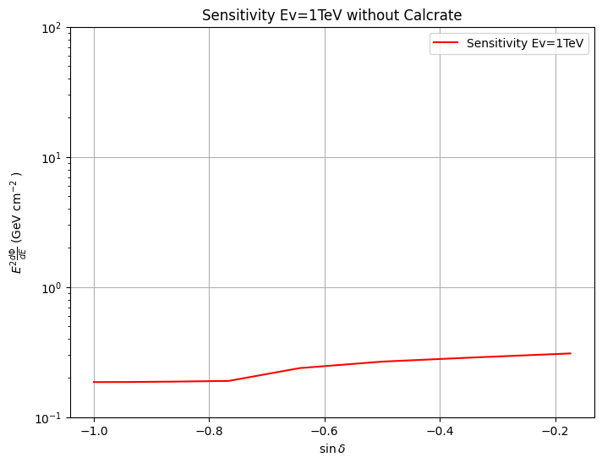
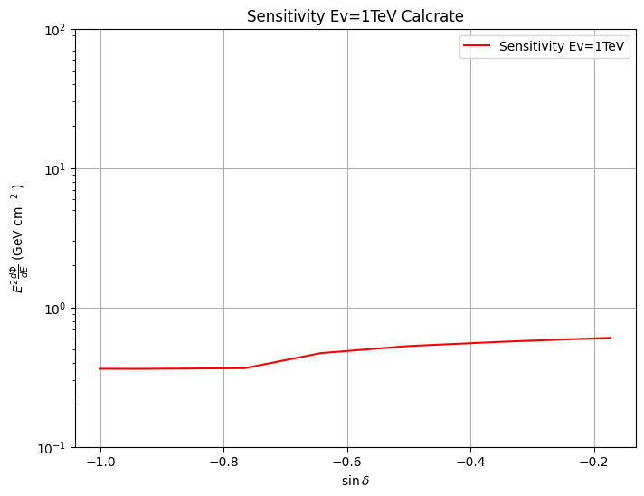
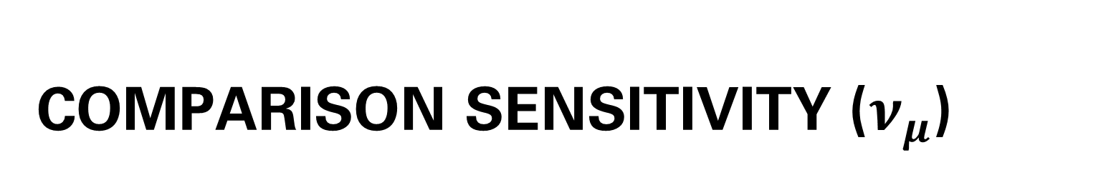
Comparison sensitivity ($ν_{μ}$)
Preliminary results
Preliminary results

Slide 10
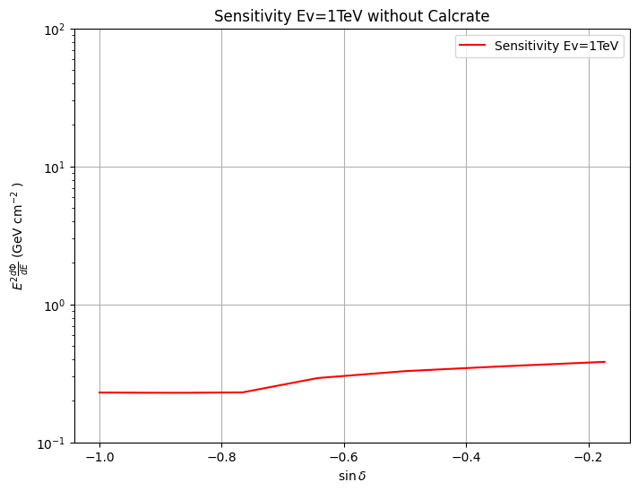
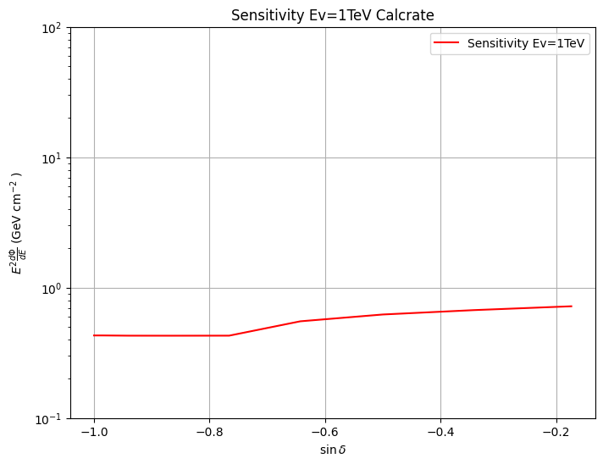
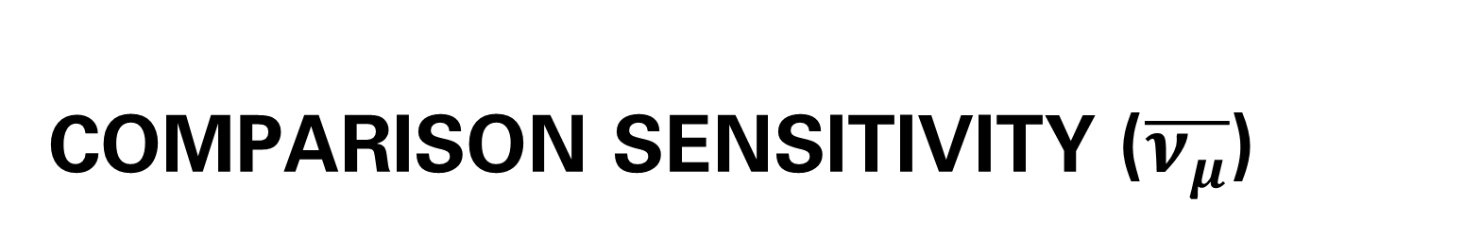
Comparison sensitivity ($\overline{ν_{μ}}$)
Preliminary results
Preliminary results

Slide 11
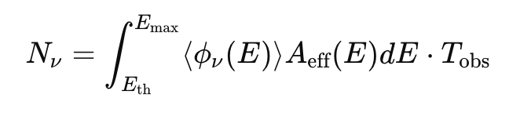
Next step
How to deal with Calcrate with our time dependent flux?
Study expectations for sources in the catalog
Average fluence ->

Slide 12
SN IIn

Slide 13
MODELING THE FLUX
We studied first SN IIn emission model, with s=2.0.
We have analyzed the time window between$t_{onset}={10}^{5.8} and t_{νmax}{={10}^{7.5}}$
$$t_{νmax}{−t_{onset}=358,7 days∼1 years}$$

Slide 14
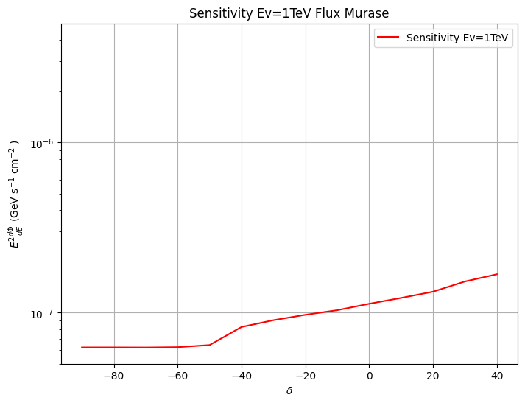
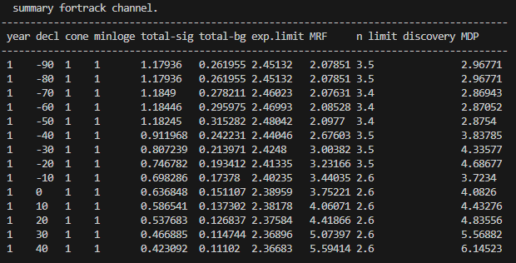
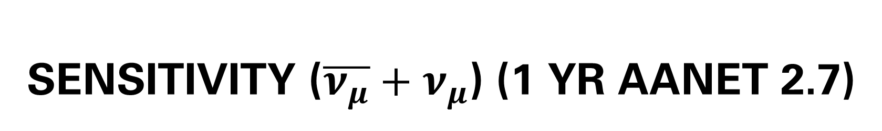
sensitivity ($\overline{ν_{μ}}+ν_{μ}$) (1 yr Aanet 2.7)
Sn IIn model by Murase, source distance d=1Mpc, numu+anumu
Preliminary results

Slide 15
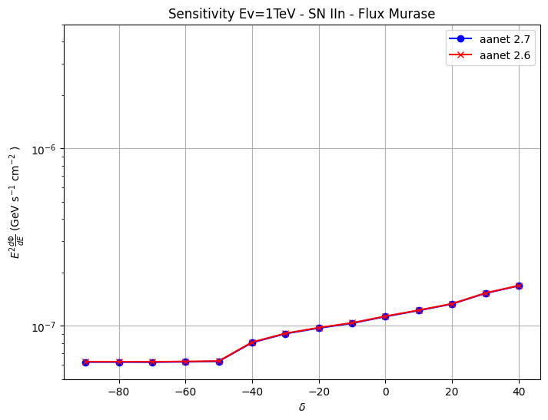
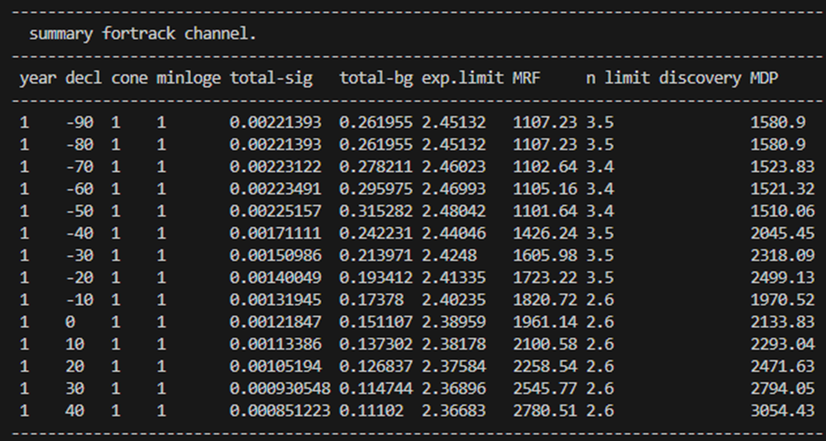
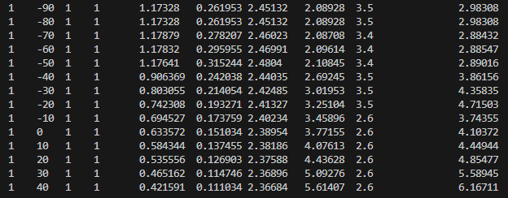
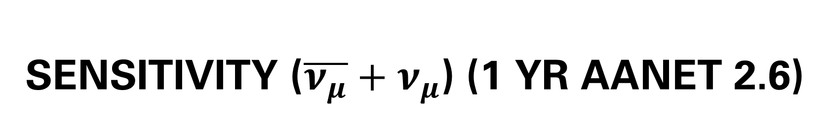
sensitivity ($\overline{ν_{μ}}+ν_{μ}$) (1 yr aanet 2.6)
Sn IIn model by Murase, source distance d=1Mpc, numu+anumu
Preliminary results

Slide 16
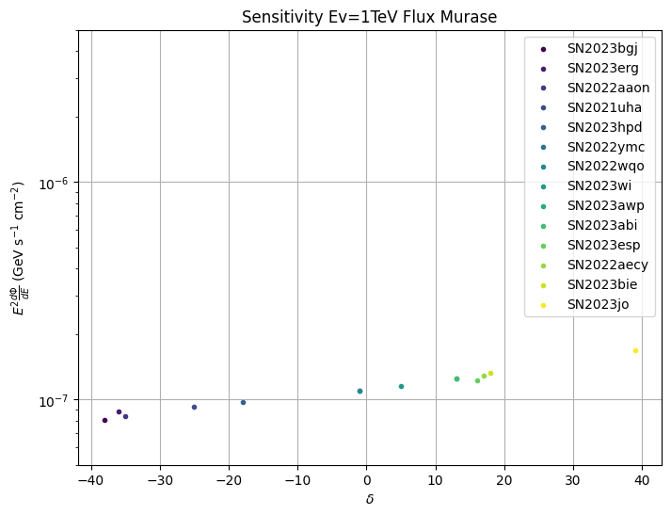

sensitivity ($\overline{ν_{μ}}+ν_{μ}$) (1 yr)
SN IIn sources from my catalog:
ARCA21 period;
KM3NeT/ARCA field of view (dec from -90° to 40°);
NO cut on the distance.
Preliminary results

Slide 17
SN Iin ARCA8+ARCA19 +ARCA21

Slide 18
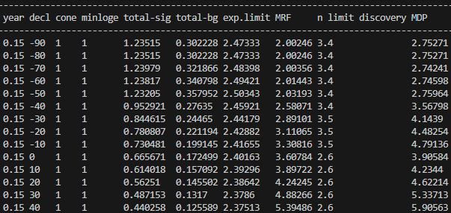
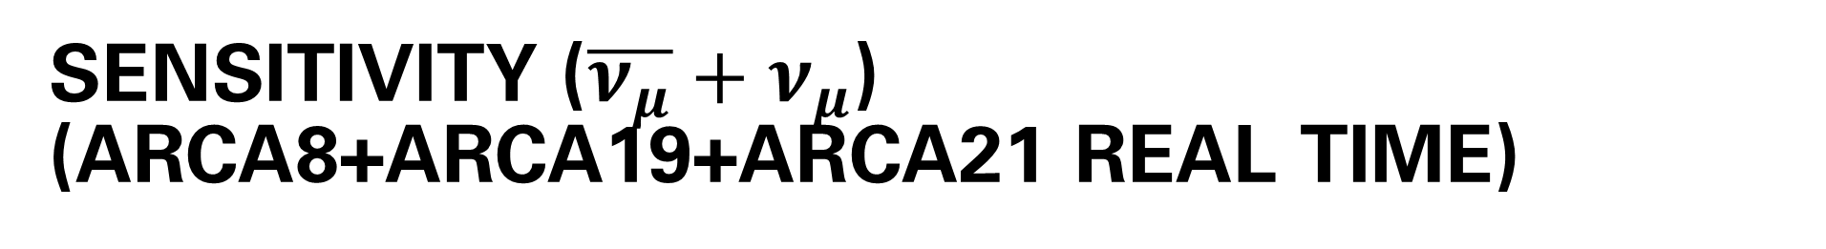
sensitivity ($\overline{ν_{μ}}+ν_{μ}$) (arca8+arca19+arca21 real time)
Sn IIn model by Murase, source distance d=1Mpc, numu+anumu
Preliminary results

Slide 19
SN IIP – ARCA21

Slide 20
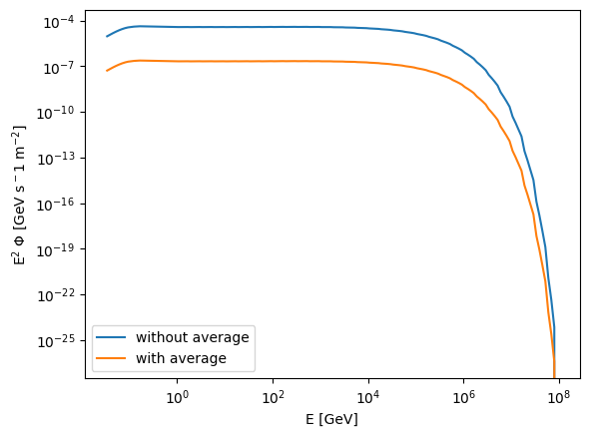
Modeling the flux

Slide 21
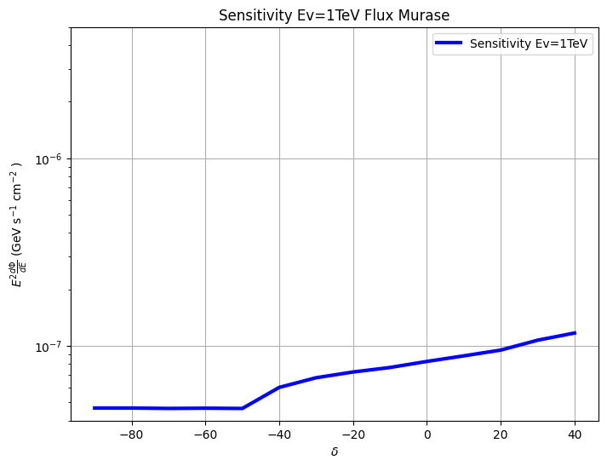
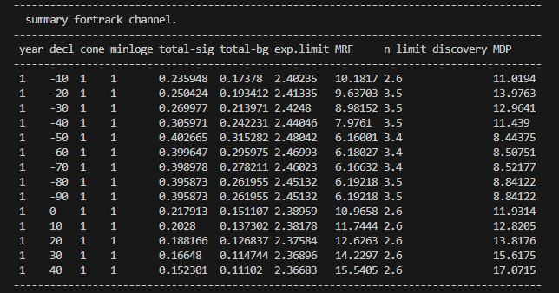

sensitivity ($\overline{ν_{μ}}+ν_{μ}$) (1 yr)
Sn IIP model by Murase, sources distance d=1Mpc, numu+anumu
Preliminary results

Slide 22
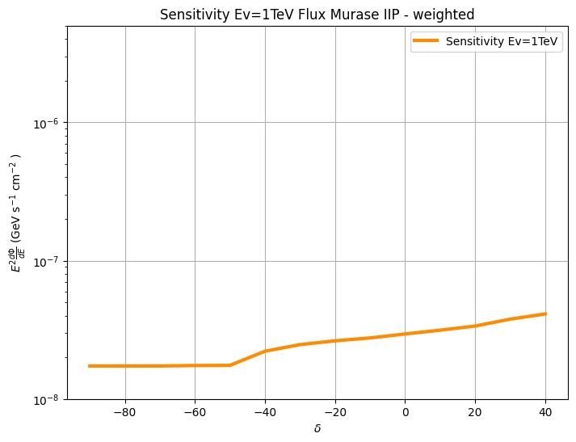
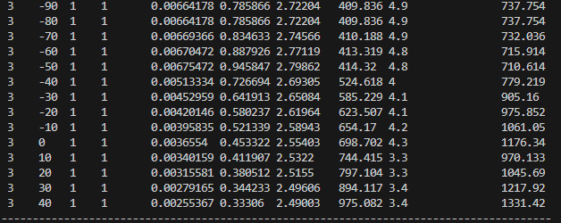
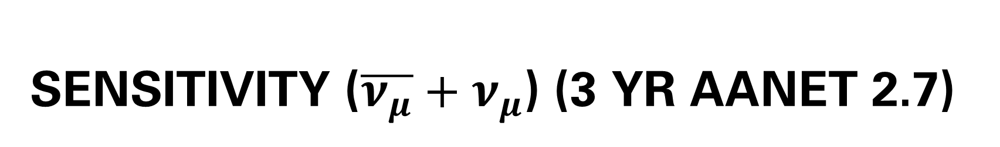
sensitivity ($\overline{ν_{μ}}+ν_{μ}$) (3 yr aanet 2.7)
Sn IIP model by Murase, sources distance d=1Mpc, numu+anumu
Preliminary results

Slide 23
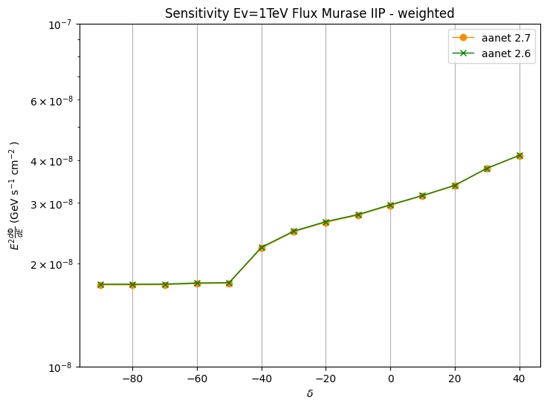
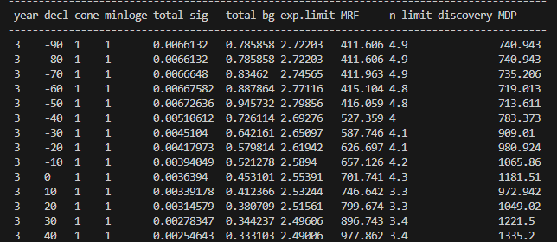
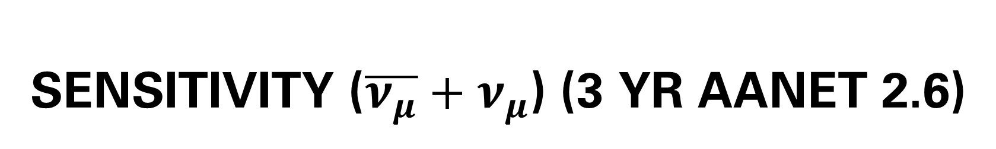
sensitivity ($\overline{ν_{μ}}+ν_{μ}$) (3 yr aanet 2.6)
Sn IIP model by Murase, sources distance d=1Mpc, numu+anumu
Preliminary results

Slide 24
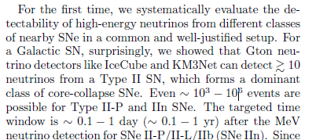
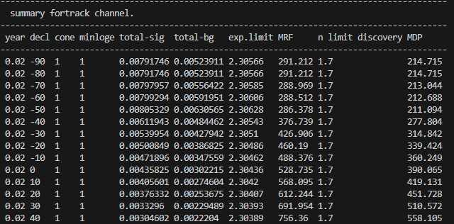
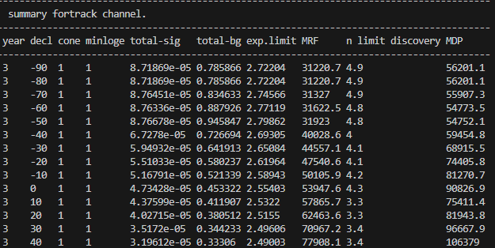
First period IIP – time window ≈ 6 days
Second period IIP – time window ≈ 3 years

Slide 25
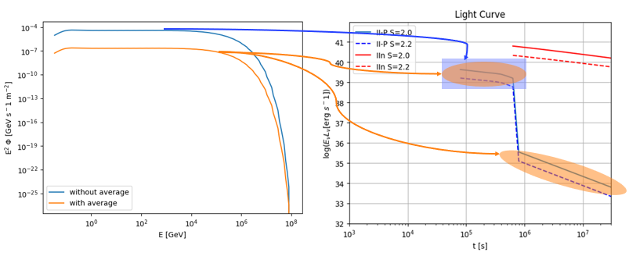
Question about the sources
-> Looking at what Murase says about the time window : Do i have to consider the average flux in a time windows of 1 day or do i have to consider only the flux1 (before the step) ?

Slide 26
SN IIP – ARCA8

Slide 27
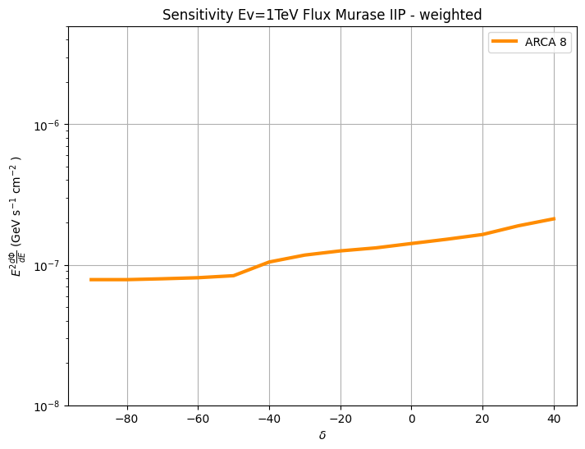
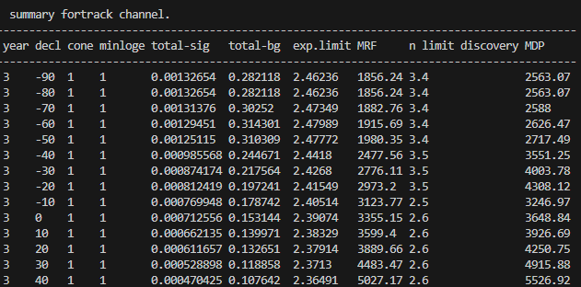

sensitivity ($\overline{ν_{μ}}+ν_{μ}$) (3 yr)
Sn IIP model by Murase, sources distance d=1Mpc, numu+anumu
Preliminary results
Preliminary results

Slide 28
SN IIP – ARCA19

Slide 29
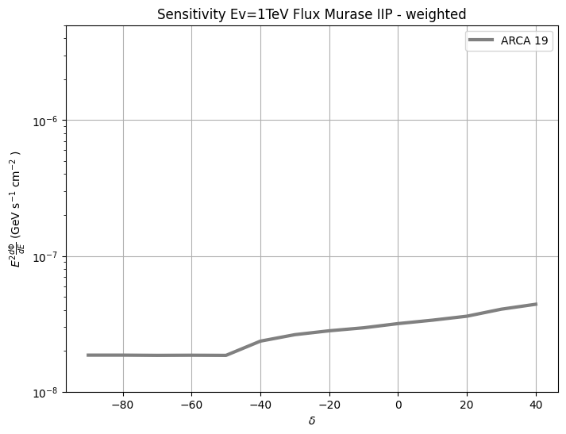
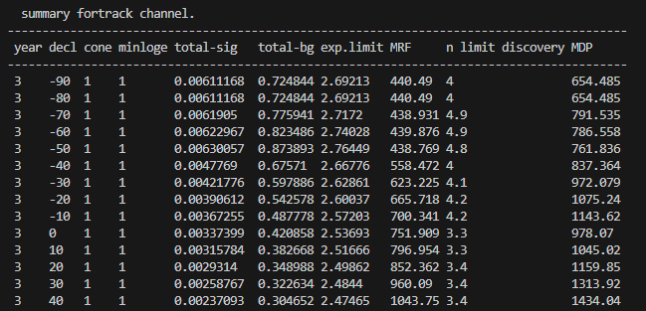
sensitivity ($\overline{ν_{μ}}+ν_{μ}$) (3 yr)
Sn IIP model by Murase, sources distance d=1Mpc, numu+anumu
Preliminary results
Preliminary results

Slide 30
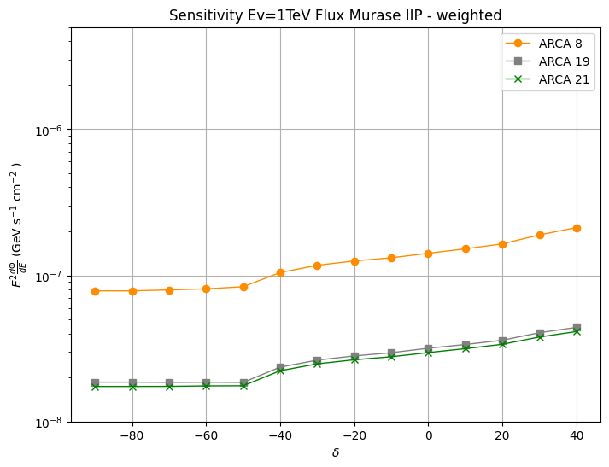
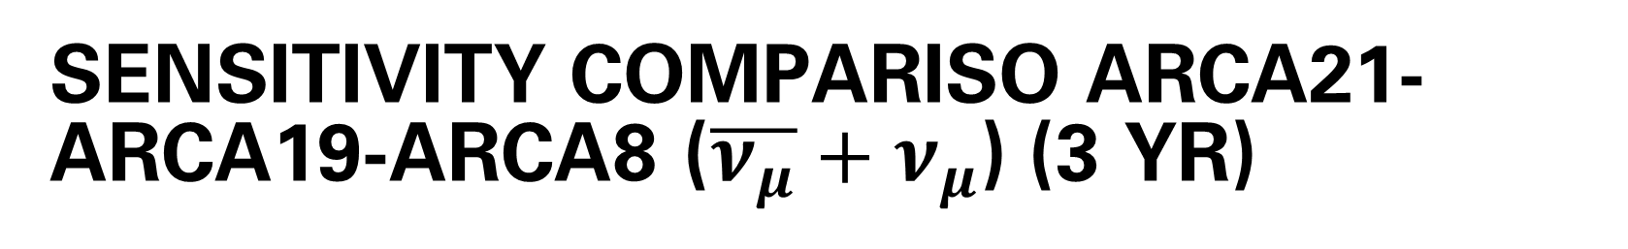
Sensitivity COMPARISO ARCA21-ARCA19-ARCA8 ($\overline{ν_{μ}}+ν_{μ}$) (3 yr)
Sn IIP model by Murase, sources distance d=1Mpc, numu+anumu

Slide 31
SN IIP – ARCA19+ARCA21

Slide 32
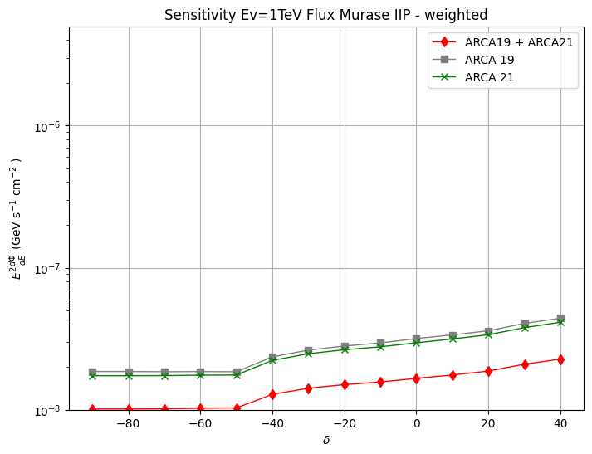
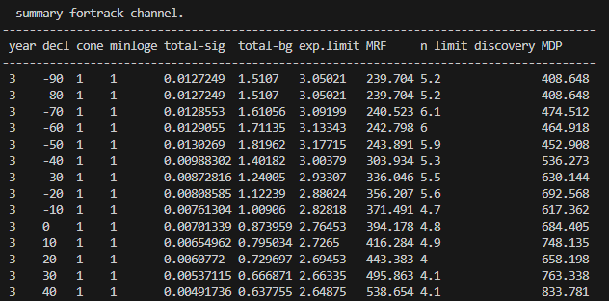
sensitivity ($\overline{ν_{μ}}+ν_{μ}$) (3 yr)
Sn IIP model by Murase, sources distance d=1Mpc, numu+anumu
Preliminary results
Preliminary results

Slide 33
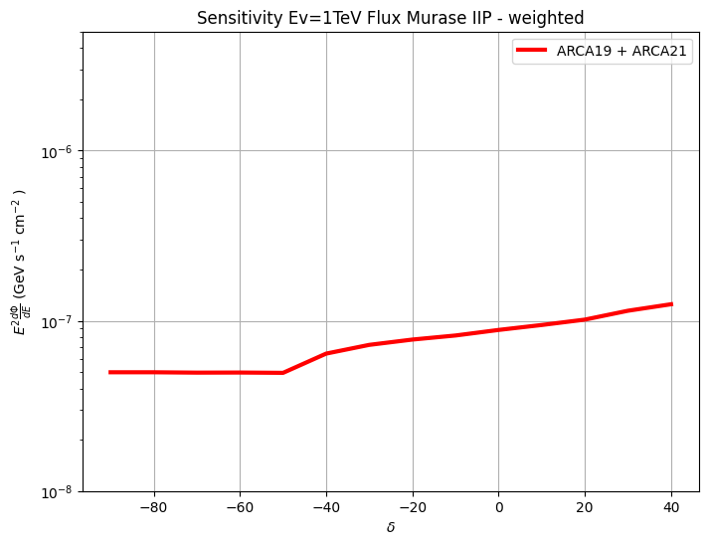
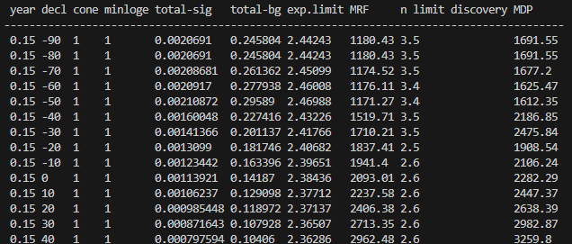

sensitivity ($\overline{ν_{μ}}+ν_{μ}$) (ARCA19+ARCA21 REAL TIME)
Sn IIP model by Murase, sources distance d=1Mpc, numu+anumu
Preliminary results
Preliminary results

Slide 34



sensitivity ($\overline{ν_{μ}}+ν_{μ}$) (ARCA19 REAL TIME)
Sn IIP model by Murase, sources distance d=1Mpc, numu+anumu
Preliminary results
Preliminary results

Slide 35


sensitivity ($\overline{ν_{μ}}+ν_{μ}$) (ARCA21 REAL TIME)
Sn IIP model by Murase, sources distance d=1Mpc, numu+anumu
Preliminary results
Preliminary results

Slide 36



sensitivity ($\overline{ν_{μ}}+ν_{μ}$) (arca8+ARCA19+ARCA21 REAL TIME)
Sn IIP model by Murase, sources distance d=1Mpc, numu+anumu
Preliminary results
Preliminary results

Slide 37


Test sorgenti
ARCA21
Sorgente IIP campione ad 1 Mpc a d=-20.
Esplosa durante ARCA8 -> suppongo flusso medio per ARCA8 (flux_weighted))+ flusso ‘’finale’’ per ARCA21 (dopo il gradino per tener conto della distanza temporale tra l’esplosione effettiva e l’inizio della presa dati di ARCA21).
ARCA8

Slide 38



SN2021UHA
ARCA21
ARCA8+ARCA21
ARCA8

Slide 39
Back-up

Slide 40

Physical scenario
The core-collapse supernovae (CCSNe) explosion mechanism is driven by low energy (MeV) neutrinos, which release most of the system's gravitational binding energy.
In addition to MeV neutrinos, some CCSNe are good candidates for the production of high-energy (H-E) neutrinos (from GeV to PeV)
Notes:
The CSM-ejecta model was first proposed in Murase et al. (2011) and predicted neutrino emission times between 0.1 day to 1-year post-core bounce. This model was recently extended: this HE neutrino flux can contribute to the flux of diffuse neutrinos found by IceCube.
In the choked jet (CJ) scenario, the proposed progenitors are similar to gamma-ray bursts (GRBs), except the jets are slower and never break through the stellar envelope, leading to neutrinos without the counterpart gamma-ray emission.

Slide 41
Physical scenario
The potential to extend the detection horizon past the Magellanic Clouds through detecting HE neutrinos has to be explored.
These neutrinos could give us also an insight into the cosmic ray acceleration processes, which are inaccessible with the low-energy neutrinos produced through nuclear processes in supernovae.
We consider two production mechanisms
for H-E neutrinos in CCSNe:
interaction between SN ejecta and CSM
(Murase 2018)
relativistic choked jets
(Enberg et al. 2009)
Prospects for extending the core-collapse supernova detection horizon using high-energy neutrinos (https://arxiv.org/pdf/2206.00450)
Notes:
The CSM-ejecta model was first proposed in Murase et al. (2011) and predicted neutrino emission times between 0.1 day to 1-year post-core bounce. This model was recently extended: this HE neutrino flux can contribute to the flux of diffuse neutrinos found by IceCube.
In the choked jet (CJ) scenario, the proposed progenitors are similar to gamma-ray bursts (GRBs), except the jets are slower and never break through the stellar envelope, leading to neutrinos without the counterpart gamma-ray emission.

Slide 42

Emission model
Model
The model used for our studies is the one described in the Murase’s works ([1], [2])
The neutrino energy fluence is described as follows:
SNe Candidates
CSM interaction candidates: SN type IIn and II-P
Relativistic CJs candidates: SN type Ib/c and IIb
Fraction of energy carried by CR
Spectrum dependent factor
We started focusing on H-E neutrinos from CSM interaction production mechanism.
}
Proton momentum index
Spectrum dependent factor
pp optical depth
Notes:
About the CSM : Optical observations of various types of extragalactic SNe have provided cumulative evidence that a SN progenitor commonly experiences a significant mass loss, just before the explosion. As result shock interactions with CSM should occur.
This kind of mechanism is well explained in Murase’s works.
Also, Es and Rcr10 is a spectrum dependent factor that converts the bolometric CR energy to the differential CR energy
At the same time we are producing the catalogue. To do so, the guidelines we followed are ->

Slide 43


Emission model
Notes:
The CSM-ejecta model was first proposed in Murase et al. (2011) and predicted neutrino emission times between 0.1 day to 1-year post-core bounce. This model was recently extended: this HE neutrino flux can contribute to the flux of diffuse neutrinos found by IceCube.
In the choked jet (CJ) scenario, the proposed progenitors are similar to gamma-ray bursts (GRBs), except the jets are slower and never break through the stellar envelope, leading to neutrinos without the counterpart gamma-ray emission.

Slide 44

Sources catalog
Producing the catalogue consists of
selecting SNe Type II (IIn or IIP);
choosing the sources according to the life time of ARCA (from ARCA6 to ARCA21);
selecting the declinations in the range from -90° to 40° (according to KM3NeT field of view)
Notes:
The CSM-ejecta model was first proposed in Murase et al. (2011) and predicted neutrino emission times between 0.1 day to 1-year post-core bounce. This model was recently extended: this HE neutrino flux can contribute to the flux of diffuse neutrinos found by IceCube.
In the choked jet (CJ) scenario, the proposed progenitors are similar to gamma-ray bursts (GRBs), except the jets are slower and never break through the stellar envelope, leading to neutrinos without the counterpart gamma-ray emission.

Slide 45
Plan for the analysis
Estimation of the sensitivity for different configurations of ARCA detector to H-E 𝝂 coming from SN explosion.
Time dependent unbinned Likelihood using Aanet
Cut&Count analysis
Two approaches to be compared:
Preliminary study: Evaluation of the expected number of neutrino events using the model and different configurations of ARCA
Notes:
The CSM-ejecta model was first proposed in Murase et al. (2011) and predicted neutrino emission times between 0.1 day to 1-year post-core bounce. This model was recently extended: this HE neutrino flux can contribute to the flux of diffuse neutrinos found by IceCube.
In the choked jet (CJ) scenario, the proposed progenitors are similar to gamma-ray bursts (GRBs), except the jets are slower and never break through the stellar envelope, leading to neutrinos without the counterpart gamma-ray emission.

Slide 46


Plan for the analysis
We chose to plot the number of events vs. the source distance in a range from 10 Kpc to 10 Mpc, for each declination —> SN type IIn
ARCA21
ARCA21
Notes:
The CSM-ejecta model was first proposed in Murase et al. (2011) and predicted neutrino emission times between 0.1 day to 1-year post-core bounce. This model was recently extended: this HE neutrino flux can contribute to the flux of diffuse neutrinos found by IceCube.
In the choked jet (CJ) scenario, the proposed progenitors are similar to gamma-ray bursts (GRBs), except the jets are slower and never break through the stellar envelope, leading to neutrinos without the counterpart gamma-ray emission.

Slide 47


Plan for the analysis
We chose to plot the number of events vs. the source distance in a range from 10 Kpc to 10 Mpc, for each declination —> SN type IIP
ARCA21
ARCA21
Notes:
The CSM-ejecta model was first proposed in Murase et al. (2011) and predicted neutrino emission times between 0.1 day to 1-year post-core bounce. This model was recently extended: this HE neutrino flux can contribute to the flux of diffuse neutrinos found by IceCube.
In the choked jet (CJ) scenario, the proposed progenitors are similar to gamma-ray bursts (GRBs), except the jets are slower and never break through the stellar envelope, leading to neutrinos without the counterpart gamma-ray emission.

Slide 48




CUT&COUNT ANALYSIS
Using calcrate only for bkg ($ν_{μ})$
My code output for n_sig e MRF
Using calcrate only for bkg ($\overline{ν_{μ}})$

Slide 49



CUT&COUNT ANALYSIS
Passing my flux to Calcrate2.py with GraphFlux()
$$ν_{μ}$$
$$\overline{ν_{μ}}$$

Slide 50


MRF – 10Kpc sn iin

Slide 51

sensitivity ($\overline{ν_{μ}}+ν_{μ}$) (1 yr)
Sn IIP model by Murase, sources distance d=1Mpc, numu+anumu
Preliminary results

